Slide 1
The Future of WORK
Stephen Murgatroyd, Phd, FBPS, FRSA

Slide 2
The Big Ideas
Work has changed dramatically since 2000
  Contingent workers
  Nature of work as a process
Work will change significantly by 2030 due to technology
  Artificial intelligence and robotics
  New kinds of manufacturing - 3D printing of medical devices, houses, cars
  Demographic shifts
  Uberization carries major challenges for all organizations / public policy
Need to rethink the place of work in the lives of people

Slide 3
Idea 1: Work Has Changed

Slide 4
Contingent and Self Employment Growing
By the year 2000 in Canada, app. 50% of the workforce were contingent workers – contracted for service rather than employees. 16% declare themselves in this way as self-employed.
Largest number of contingent workers are young people under the age of 35.
Canada has the 3rd largest contingent workforce in the world behind New Zealand (#1) and the US (#2).
Year | Total Self-Employed (Canada)
1987 | 1,699,100
2007 | 2,598,600
2017 | 2,875,900

Slide 5
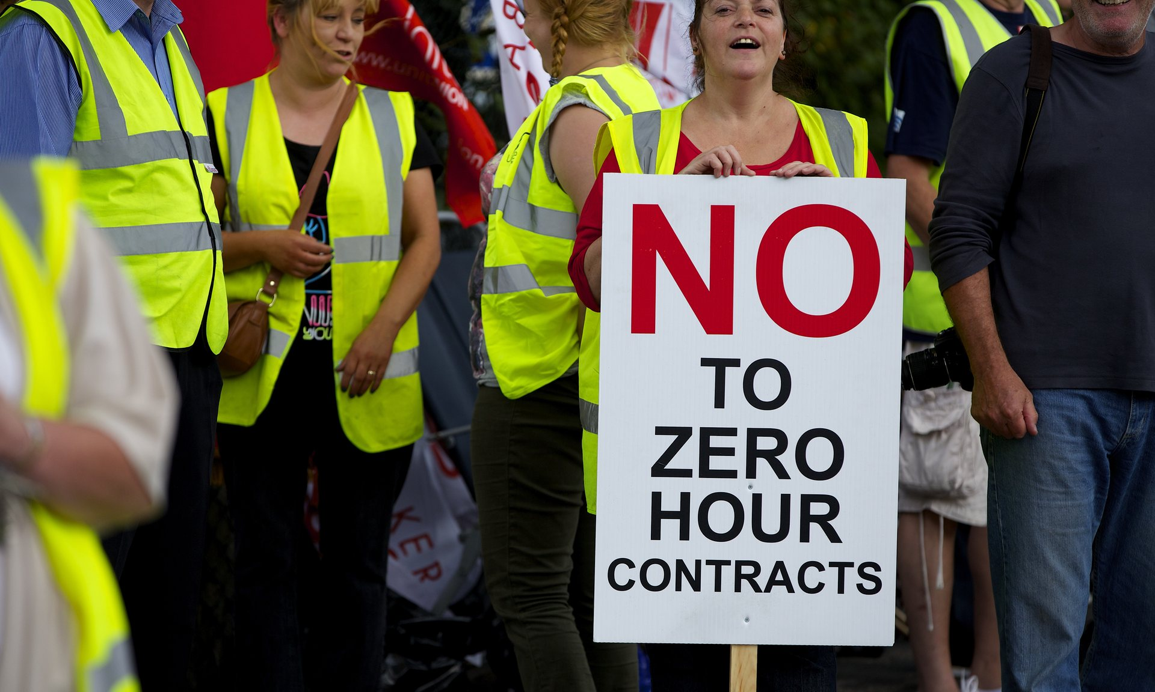
Top Ten Markets for Contingent Workers – Most Availability
Israel
United States
Australia
Ireland
New Zealand
Canada
United Kingdom
Singapore
Norway
Netherlands
In the United Kingdom in 2016 there were 900,000 people on zero hours contracts – “just in time” workers contracted to specific organizations.

Slide 6

The Gig Economy IS the Economy..
Worldwide, 40% of the world’s workforce are contingent workers and this number is expected to rise to 60% by 2020.
In the Fortune 100 companies, contingent workers make up 30% of the workforce, but predictions are that will soon rise to 50%.

Slide 7
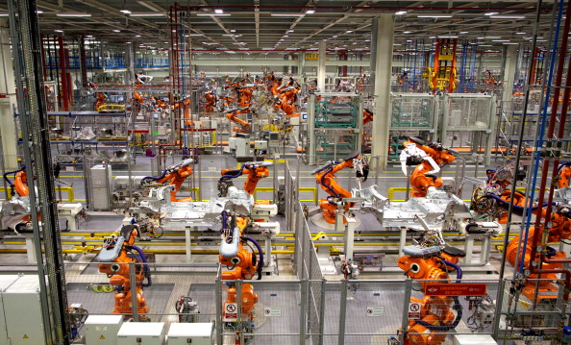
Not Only Has WHO is working changed, but WHAT they do has too
Manufacturing more focused on the management of technology than production activity – maintenance.
Artificial intelligence + design = new thinking about process.
Office work has changed – 24x7 access, process based work, globalization of work..
Outsource + Insource – 24x7 work
BMW Mini Plant at Cowley, Oxford UK
A customized car every 61 seconds

Slide 8
Idea 2: More Change to Come
Technology

Slide 9
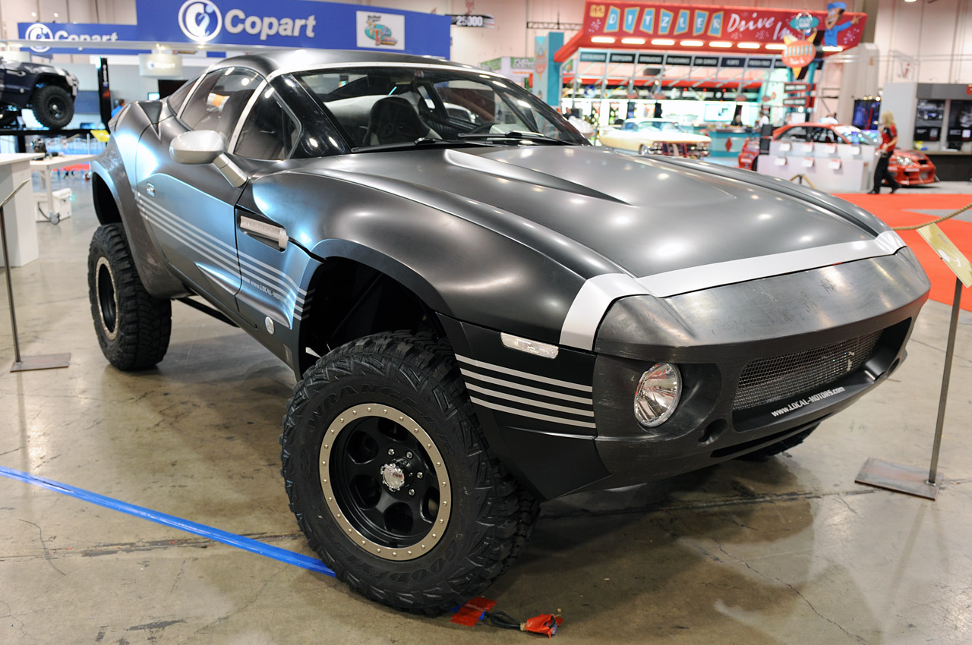
Emerging Technology: 3D Printing
Local Motors (Phoenix, Arizona) crowdsources design and engineering and then 3D prints its components / body.
Manufactures customized versions on demand.
Manufactures all forms of transport, including snowmobiles, water based vehicles and public transport.
First driverless 3d printed public bus now operating in Helsinki

Slide 10
3D Printing Quickly Emerging…
A group of Dutch engineers have printed a bridge crossing a Dutch canal using an “arm printer”, overcoming the size limitations of 1st and 2nd generation 3D printers.
3D medical devices – prosthetics, stents, dental devices and other – already a fast growing sector: the ability to personalize / customize a strong attractor.
Using a cell phone as a printer (light from the phone used on polymers to print)
Elon Musk and his engineers at SpaceX have created a 3D printed SuperDraco rocket engine. This got off the ground in 2016.
3D printing now includes:
  Houses (several places, but also China and India) and sleeping pods (Africa)
  Aerospace parts (European Space Agency)
  Metal parts
  Medical devices

Slide 11
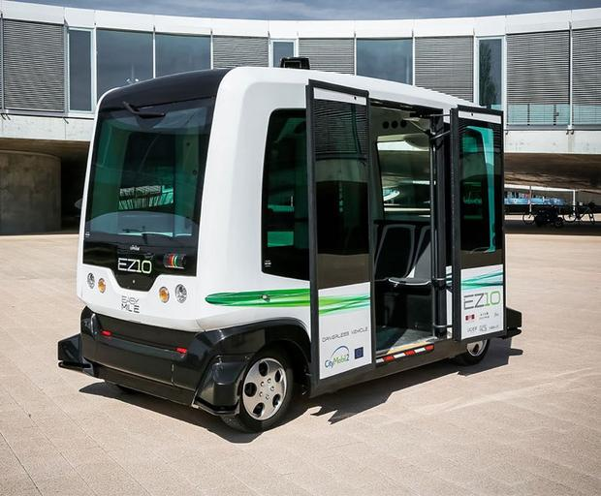
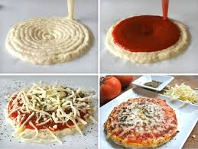
3D Printing in 2016
Driverless Bus Helsinki
3d Printed Food

Slide 12
Robotics
Forget many of the images you have of what robots are and what they can do..
Imagine..
  Robotic kitchens which can produce meals on demand..
  Robotic weapons and fight systems
Self-driving cars, buses, trains and trucks likely to replace current transport systems over time – potential displacement of some 3.5 million North American workers by 2030
570,000 surgeries in 2014 were robotically assisted

Slide 13

Artificial Intelligence (AI)
Offering an analysis of an MRI scan – suggesting clinical pathways based on “best possible” understanding
Predicting student behaviour
Counselling and personal therapy..
Supports for design and creativity
Man-machine interfaces for better productivity – especially in manufacturing, financial services and health
The Singularity – Where AI is smarter than the collective intelligence of the species

Slide 14
Idea 2: More Change to Come
Demography

Slide 15

Basic Demography (Canada)
By 2030, 30% of Canadians will be over 60 years of age
There will be 2 working age people in Canada for each retiree – down from 4 in 2015.
GDP could fall by as much as 52% (McKinsey)
More seniors than students in K-12 for the first time.

Slide 16

By 2050: More Demographic Shocks..
Global population will exceed 9 billion
The proportion of the world’s population over 65 will double
There will be over 400 million persons over 80 – 4x the present number
80% of those 65 or older will live in low or middle income countries
For the first time in history, there will be more people over 65 than under 14
In Italy, Japan and Spain 1 in 3 will be over 65

Slide 17
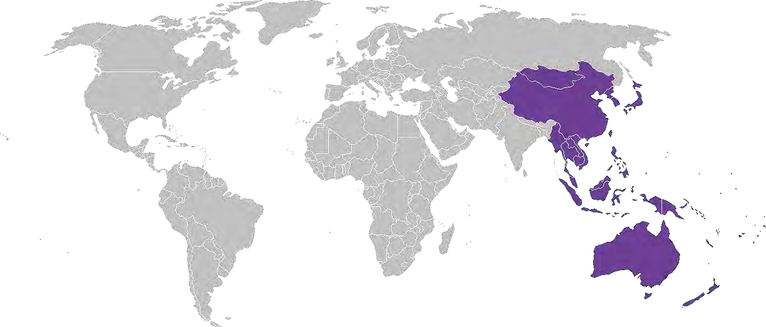
Economic Geography – Shift Happens!
2.3 billion new middle class consumers will emerge by 2030, mainly in Asia, India and Africa
By 2025 almost 50% of the world’s billion dollar companies will be headquartered in emerging markets, not in North America or Europe (41% of them are already Asian based)
425 major cities will fuel the global economy – 315 of them are in Asia

Slide 18
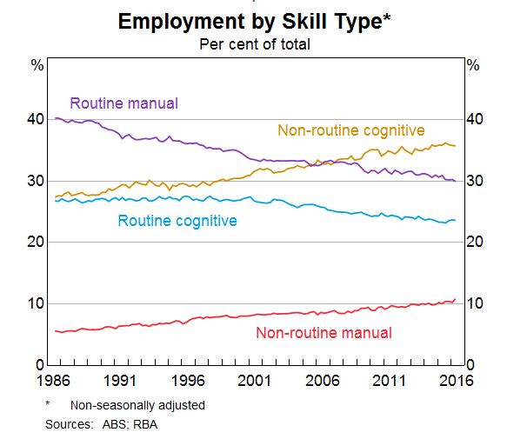
Changes in the Workforce
Shift from routine work to creative employment..
Replacement of routine work with technology – think secretarial services, banking, travel..
Higher education key to future employment..

Slide 19
Idea 2: More Change to Come
New Kinds of organizations

Slide 20
New Kinds of Organizations
Uber – matches drivers with those needing a ride..
99 Designs – matches designers with those needing design work
Rent-a-Coder – matches those with coding capabilities with those who need purpose built software / applications
Trendwatching – trend analysts track small and large data and patterns and offer their services against challenges
Amazon Go – a shop without tellers or check-out
Alibris – global bookseller which is actually a brokerage
Lynda - learning on demand (also Creative Live..)
Task-Rabbit – matching local skills with local needs (e.g. odd jobs, gardening, window cleaning, catering, tutoring…)

Slide 21
Organizational Life Cycle Shorter

Slide 22
AI+ROBOTICS = BIG DISRUPTION
World Economic Forum suggests that app. 7 million jobs will be lost and 2 million gained as a result of technological change in 15 major developed and emerging economies by 2020.
Most forecasters predict that app. 50% of current jobs will disappear by 2030, replaced by “smart” technology. Could impact 2 billion workers either by unemployment or reduced need for employment.
Major industries impacted: transport, energy, retail, education, health, insurance, communications.
4 out of 5 jobs lost in the US since 2000 are due to automation

Slide 23
Think About: Human labour no longer drives economic growth.
In 1964, the most valuable company in the US, AT&T, was worth $267 billion in today’s dollars and employed 758,611 people. Today’s telecommunications giant, Google, is worth $370 billion but has only about 55,000 employees—less than a tenth the size of AT&T’s workforce in its heyday.
Nine out of 10 workers today are in occupations that existed 100 years ago, and just 5 percent of the jobs generated between 1993 and 2013 came from “high tech” sectors like computing, software, and telecommunications. Our newest industries tend to be the most labor-efficient: they just don’t require many people. It is for precisely this reason that the economic historian Robert Skidelsky, comparing the exponential growth in computing power with the less-than-exponential growth in job complexity, has said, “Sooner or later, we will run out of jobs.”

Slide 24
So What?
Implications for Society

Slide 25
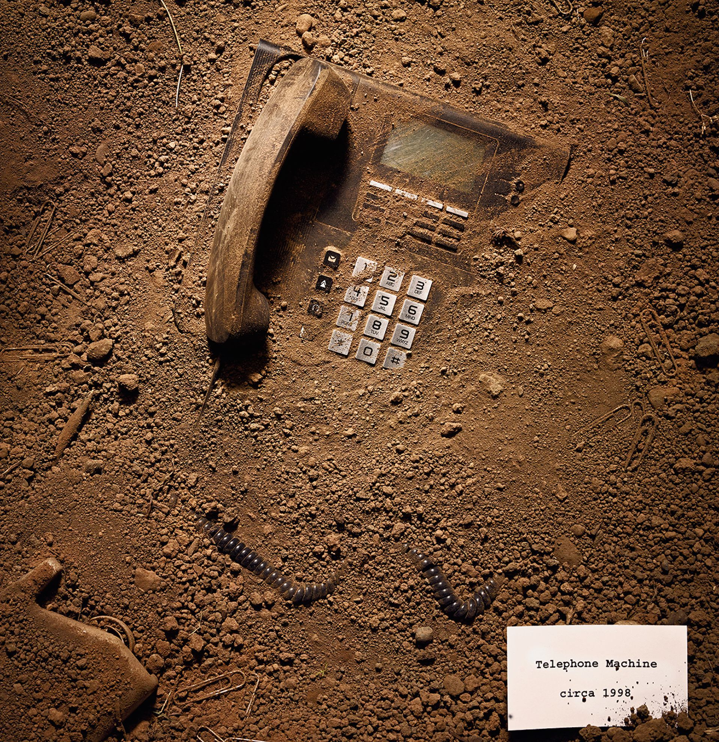
The Post-Work Economy
Characteristics
Less demand for employees, more demand for contingent workers with specialized skills
More use of global labour – 99 designs is the business model
More demand for sophisticated technology
More demand for ‘uber-like” services in many sectors, including health and education
Fewer people needed to sustain economic activity overall
Some careers “survive”, others mutate, yet others disappear

Slide 26
Some Options
Let’s all be luddites! Ban certain job-killing technologies (e.g. GMO crops, robotic grown foods, robotic teachers, self-driving trucks).
Shorter Working Week – 3 days a week (maximum) so as to spread available employment around. [Sweden has a 6 hour working day and is looking at a 3 or 4 day work week].
Rethinking social wages – living wage payments for all, guaranteed minimum wages for those who do work. De-linking wages from work.
Major infrastructure investments – linked to guaranteed public sector work provides one component of a response to technological unemployment.
Social ownership of technology – enabling all of us to share the returns on the use of the data we generate by our behaviours.
Strengthening educational access – lifetime learning guarantees for 30% of adult lifetime.
Significant investment in cultural resources – more investment in arts, leisure, music, etc. so as to provide routes to meaning.

Slide 27
The biggest enigma of the post-work society is what happens to the self when it cannot define itself against corporate identity, skill set or seniority.
Paul mason writing in the guardian, February 17th 2016
“And it’s our fulfillment, rather than the satisfaction of our appetites, that’s threatened by the slow decline of work”. Ross Douthat, New York Times, February 23rd 2016

